Slide 1

METHODOLOGY & ASSUMPTIONS
Methodology
Assumptions
For optimal number of images to be suggested to host to maximize bookings
We have analyzed the distribution of bookings across number of images uploaded along with the listings
Condition used: Boxplot with the highest 75%ile and median would represent the optimal number of images
For minimum number of images to be mandated to ensure bookings
We have calculated bookings per month (based on listing posting date)
Condition used: At least one 1 booking per month
While calculating minimum number of images to ensure bookings, we are keeping the target of at least 1 booking per month. This target can be changed from 1 booking per month to 1 booking per quarter/year and the corresponding minimum number of images required would change
Regular and super hosts have been analyzed separately due to their different nature
All listings counted in ‘Redundant Listings’ dataset are assumed to be older than Sep 1, 2018 (one year from Aug 31, 2019)
Although bookings are dependent on various factors such as review volume, location, pricing, amenities, brand, neighborhood listings, rules & regulations, etc., we have considered ‘image count’ as the one of the main factors in this analysis

Slide 2
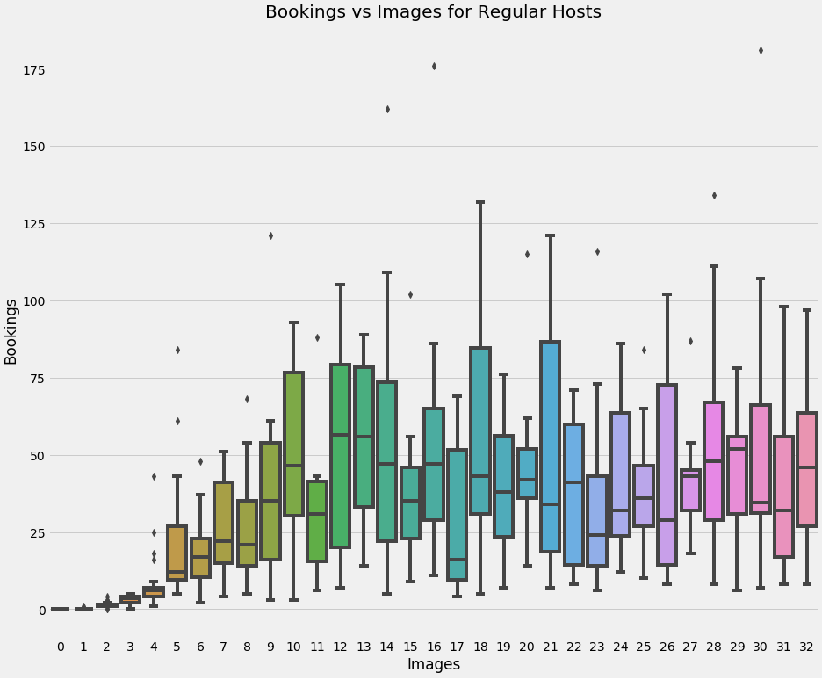
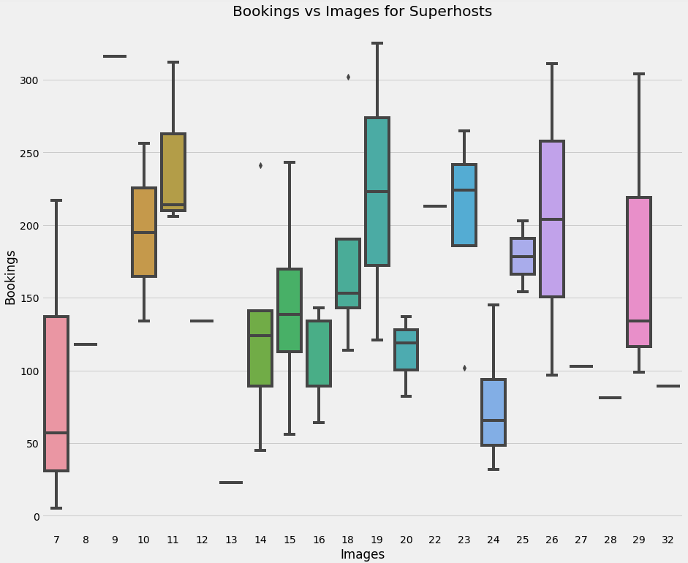
OPTIMAL NUMBER OF IMAGES TO MAXIMIZE BOOKINGS
LISTINGS WITH REGULAR HOSTS
LISTINGS WITH SUPERHOSTS
Highest median
Optimal number of images that would attract the most bookings is 12 to 13.
Optimal number of images that would attract the most bookings is 11.

Slide 3
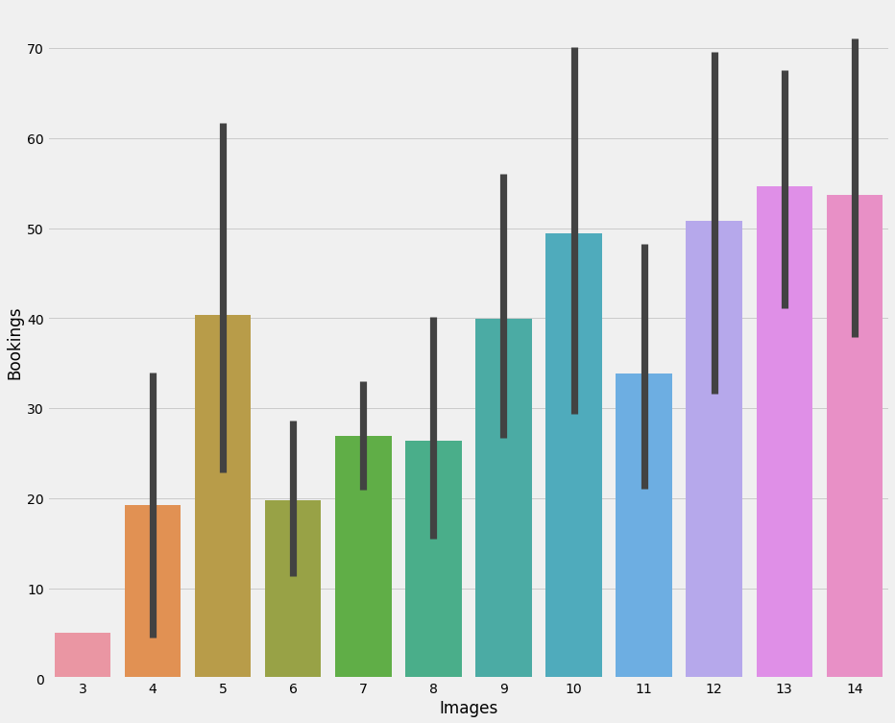
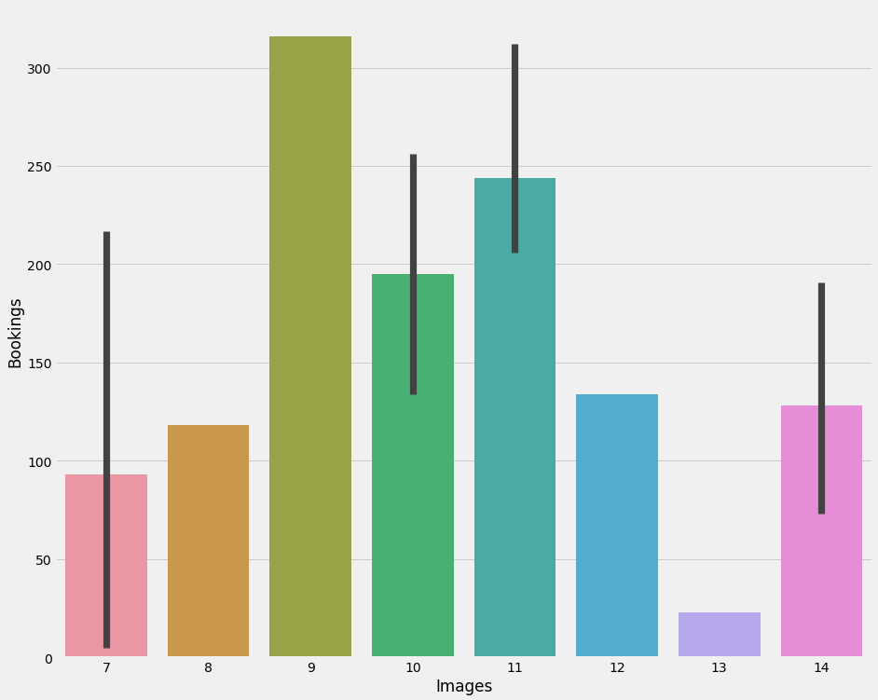
MINIMUM NUMBER OF IMAGES TO BE MANDATED
LISTINGS WITH REGULAR HOSTS
LISTINGS WITH SUPERHOSTS
Minimum 5 images per listing would ensure an average of 1 booking per month with 66% probability (40 bookings in 5 years)
Minimum 7 images per listing would ensure ~1.5 booking per month (90 bookings in 5 years)

Slide 4
SUPPORTING EVIDENCES
LISTINGS WITH REGULAR HOSTS
LISTINGS WITH ALL HOSTS
Optimal number of images found to be 12 to 13 (inside 11 to 15 image bracket) is confirmed across most of the listing ages
Optimal number of images as 12 to 13 is justified with the highest booking % for listing image bracket of 11 to 15

